Slide 1

Project Game – TEAM 2

Slide 2



CATEGORY
IDEA
STORY
FUNCTION
GAME PLAY
TAKE MONEY

Slide 3
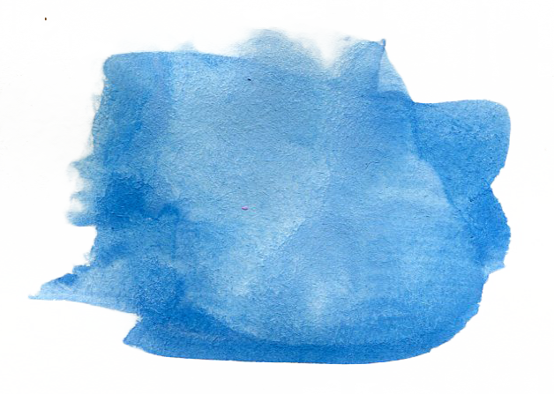
1
IDEA

Slide 4

Had inspiration from Bubble games.
Combined with
Defense games.

Slide 5
2
STORY

Slide 6


Slide 7

Watch advertisements.
Shoot sharks.
FUNCTION
Gets stars to open levels.
Gets coins to buy skins.
Buy skins (background, buttons, ships).

Slide 8

GAMEPLAY

Slide 9
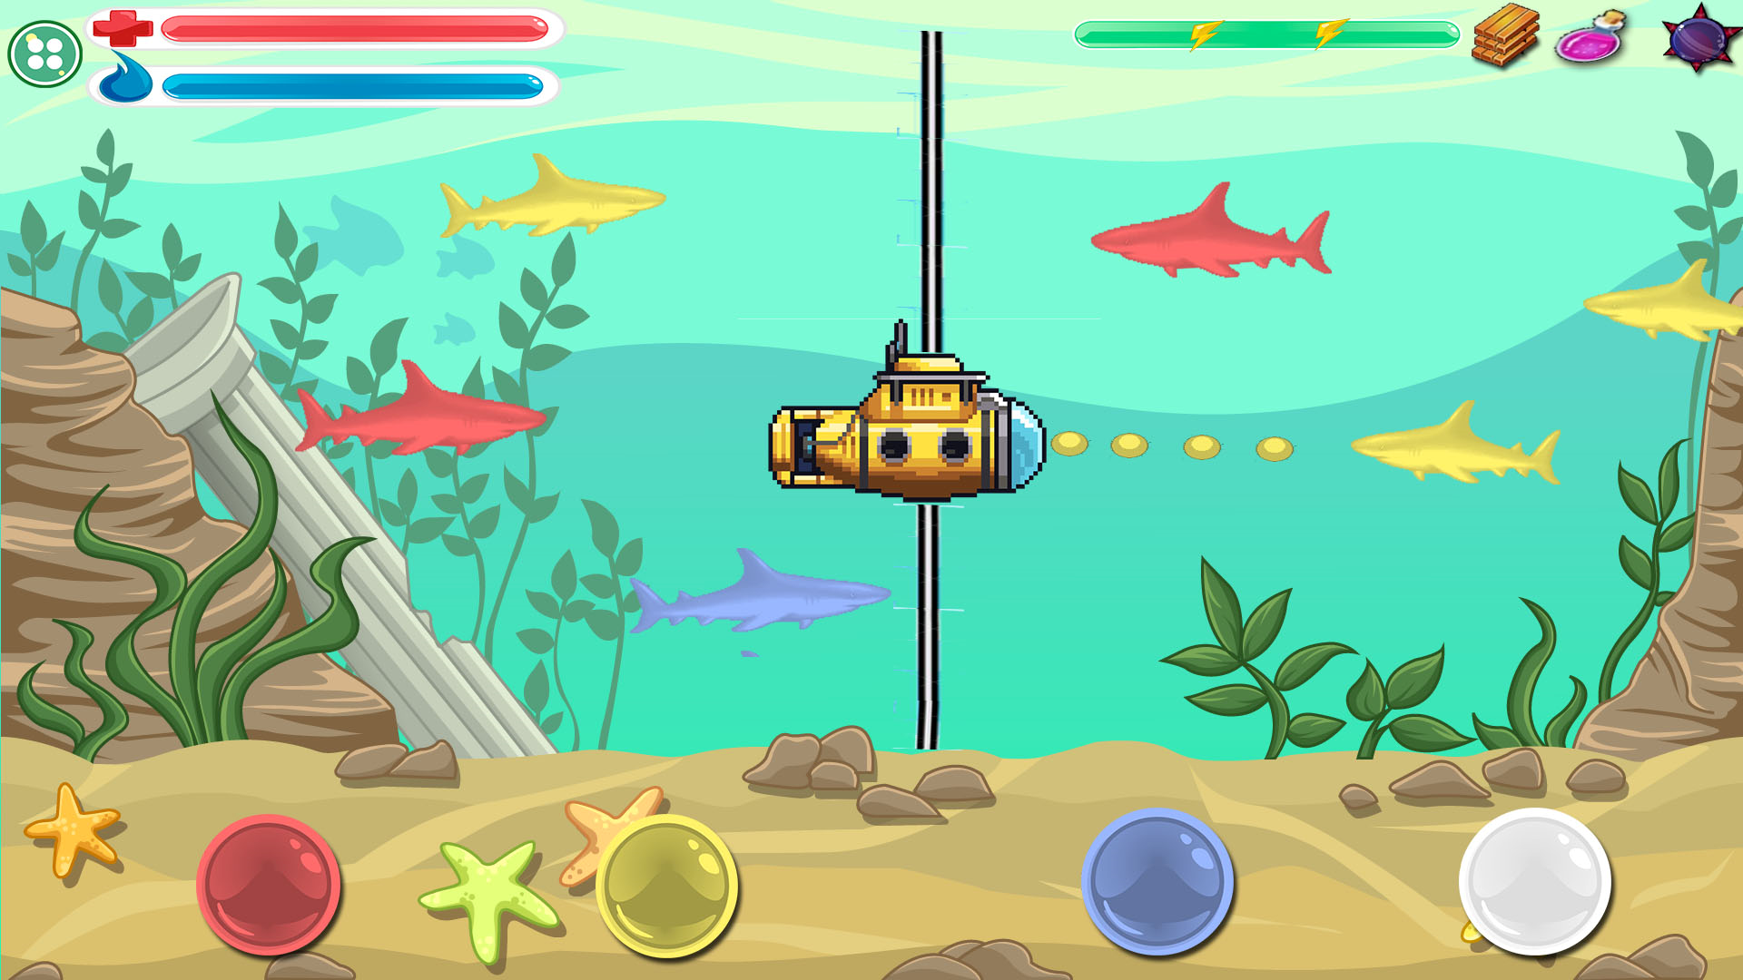

Slide 10
TAKE MONEY
Watch advertisements.
Special skins.

Slide 11
Thanks!
Any questions?

